Slide 1
Error classification
Jasper
Errors in the depth measurement using the ToF cameras
Errors
Systematic
Depth Distortion
Wiggling, Circular Error
Depends only on the measured depth for each pixel.
40%
Caused by imaging conditions.
Generally managed by calibration.
Integration-time-related error
Different IT gives different depth values.
Main reason is still under investigation.
33.3%
Built-in pixel-related errors
Due to different material properties in CMOS-gates
Due to capacitor charge time delay.
6.6%
Amplitude related errors
Gaussian beam shape.
Low illumination for each object.
Difference in object reflectance.
Temperature-related errors
Non-systematic
Temperature affects the data processing.
Just wait until the temperature reaches an adequate level.
Caused by external environments and noise.
Generally managed by filtering.
Machine Learning is also taken.
References
Foix, S., Alenyà, G., & Torras, C. (2011). Lock-in ToF Cameras - A Survey. Ieee Sensors Journal, 11(9), 1917–1926.

Slide 2
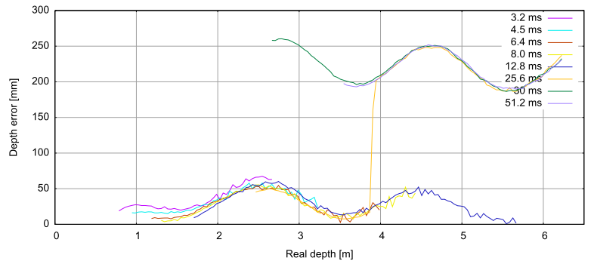
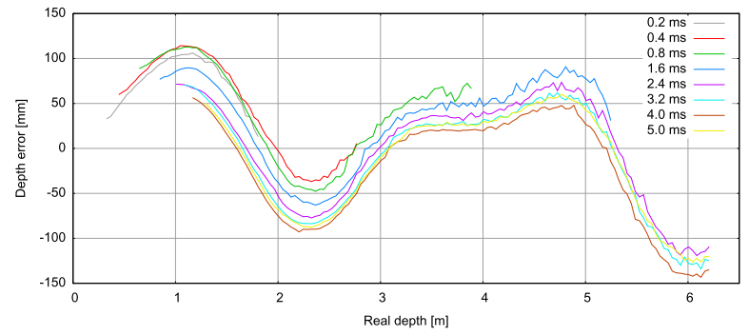
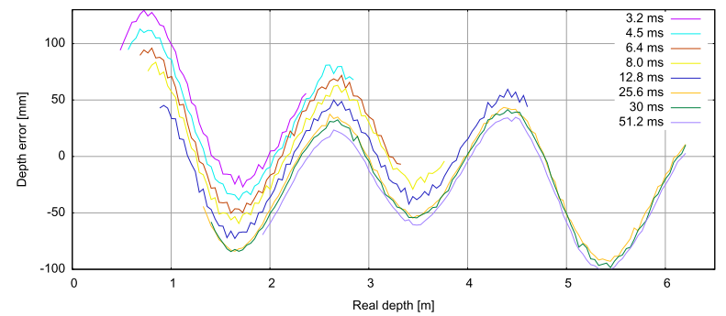
Wiggling error
Jasper
(a) PMD 19K
(c) Effector O3D
The depth error was measured in three different cameras.
For each camera, data were taken at various integration times.
All experiments show periodic behavior.
We can notice that
Wiggling error can be predicted well with a Fourier Series.
Wiggling error is independent of the integration time error.
The integration time error is related to the constant offset.
(b) SwissRanger SR-3000
Reference
Rapp, H. (2007). Experimental and Theoretical Investigation of Correlating TOF-Camera Systems.

Slide 3
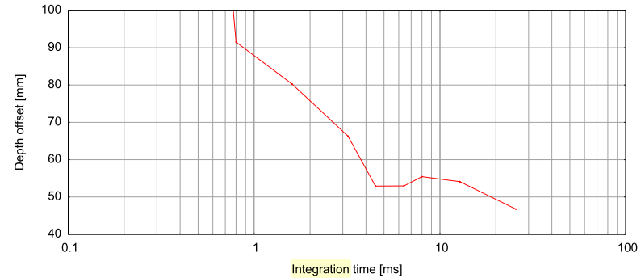
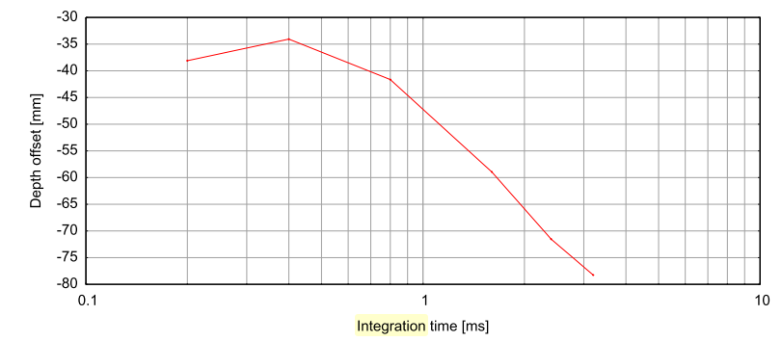
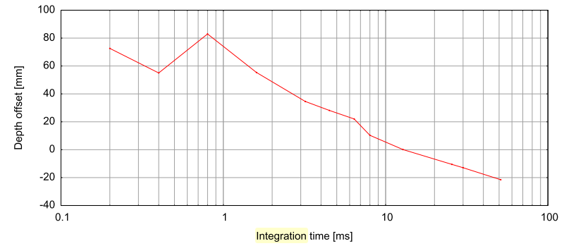
Integration-time offsets
Jasper
(a) PMD 19K
(c) Effector O3D
For all cameras, the depth error was taken at 2.5m.
The offset is dropping as the integration time gets longer.
The offset stays constant over integration time for any depth.
The reason for this offset remains unsure.
(b) SwissRanger SR-3000
Reference
Rapp, H. (2007). Experimental and Theoretical Investigation of Correlating TOF-Camera Systems.

Slide 4
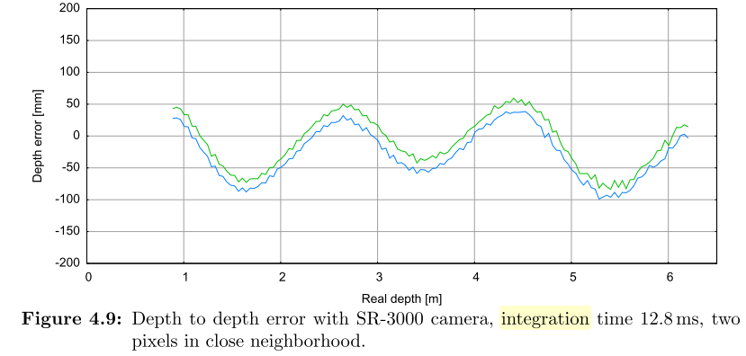
Built-in pixel related offsets
Jasper
Fixed pattern noise (FPN)
The reference signal is delayed due to the charge time of its capacitor. → A small phase shift in the reference signal → Shifting in the whole cross-correlation function.
Since the capacity of each pixel is fixed, it is constant regardless of the operating environment.
Not dark noise!
Reference
Rapp, H. (2007). Experimental and Theoretical Investigation of Correlating TOF-Camera Systems.

Slide 5
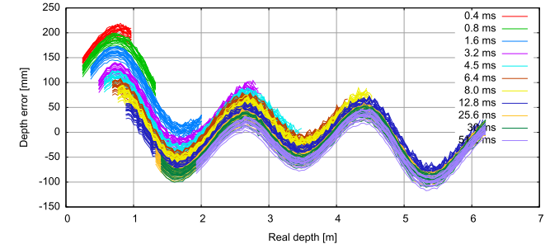
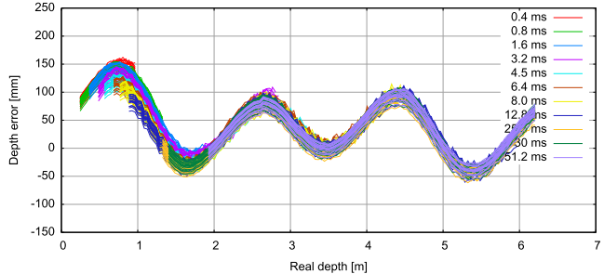
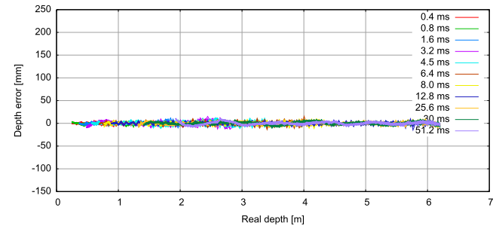
Conclusion
Jasper
Author’s suggestion for the calibration method
Uncorrected
After IT error correction
After wiggling and FPN correction
Implication to the dToF calibration method
Depth Distortion
40%
Integration-time-related error
33.3%
80% of the depth error in the iToF camera stems from the detecting mechanism.
Built-in pixel-related errors
6.6%
Understanding the mechanism of the SPAD will be crucial to the development of the dToF calibration method.
Reference
Rapp, H. (2007). Experimental and Theoretical Investigation of Correlating TOF-Camera Systems.

